Slide 1

ERASMUS + KA 122 Seasonal@Glocal
MOBILITA’ PER L’APPRENDIMENTO INDIVIDUALE FINANZIATO DALLA COMUNITA’ EUROPEA
CODICE PROGETTO: 2021-1-IT02-KA122-SCH-000013562
The origins of the name "Mirto".
Classi quarte Via dell’Arte

Slide 2
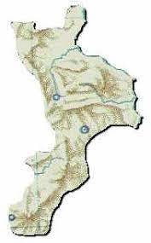
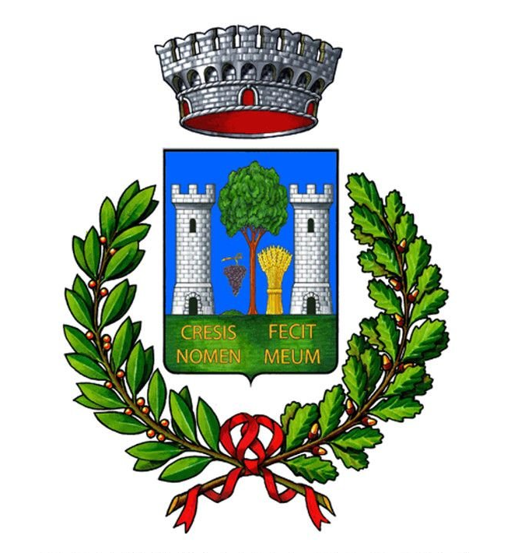
The origins of the name Mirto
The origin of the name "Mirto",
part of the municipality of
Crosia, probably derives
from the abundance
of the myrtle plant
present in the area.

Slide 3
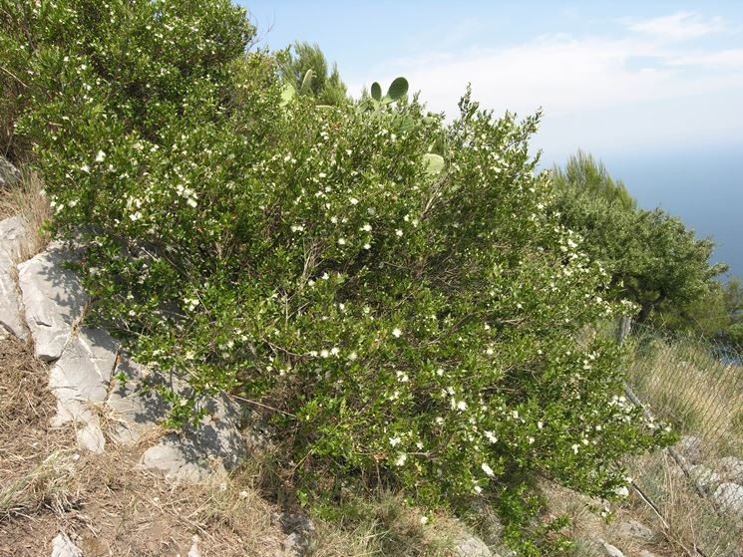
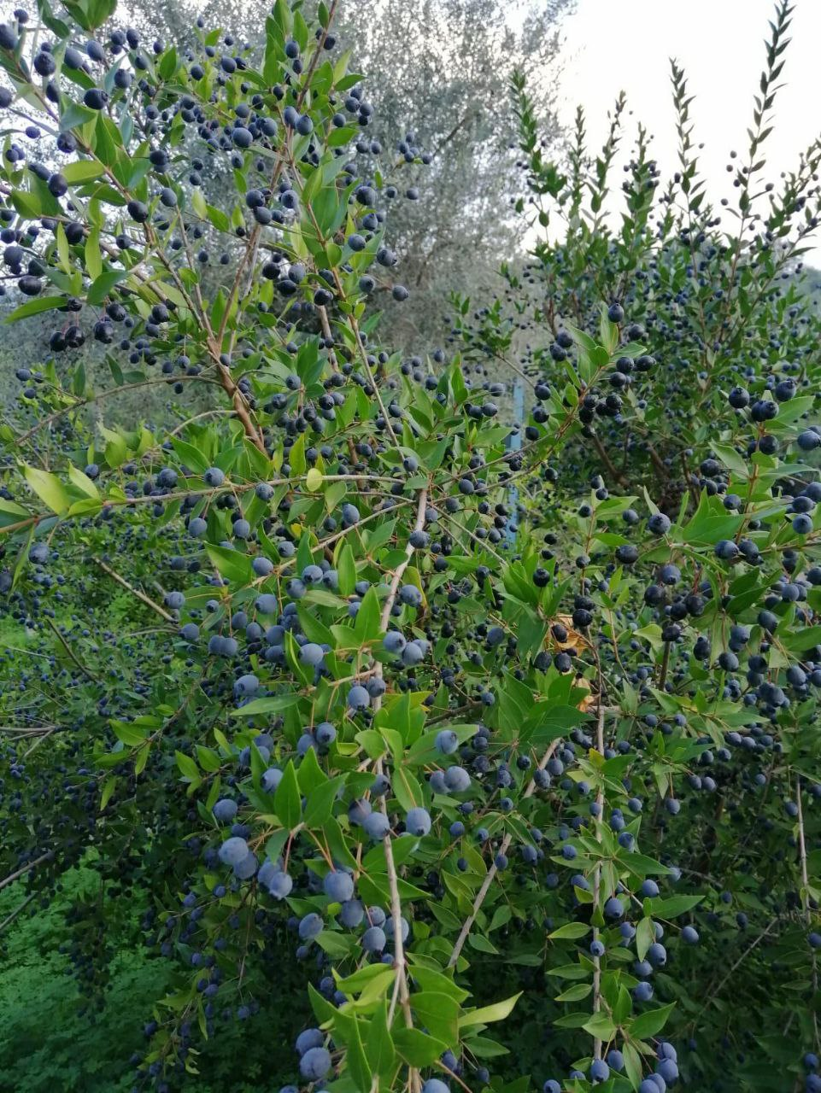
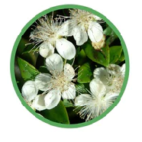
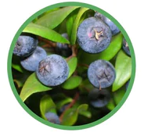
The myrtle
Blooms in summer
Fruit in autumn / winter
Myrtle is a plant belonging to the Myrtaceae family and to the Myrtus genus.
It is typical of the Mediterranean scrub, it is also called "mortella", in our dialect "mortidda".

Slide 4
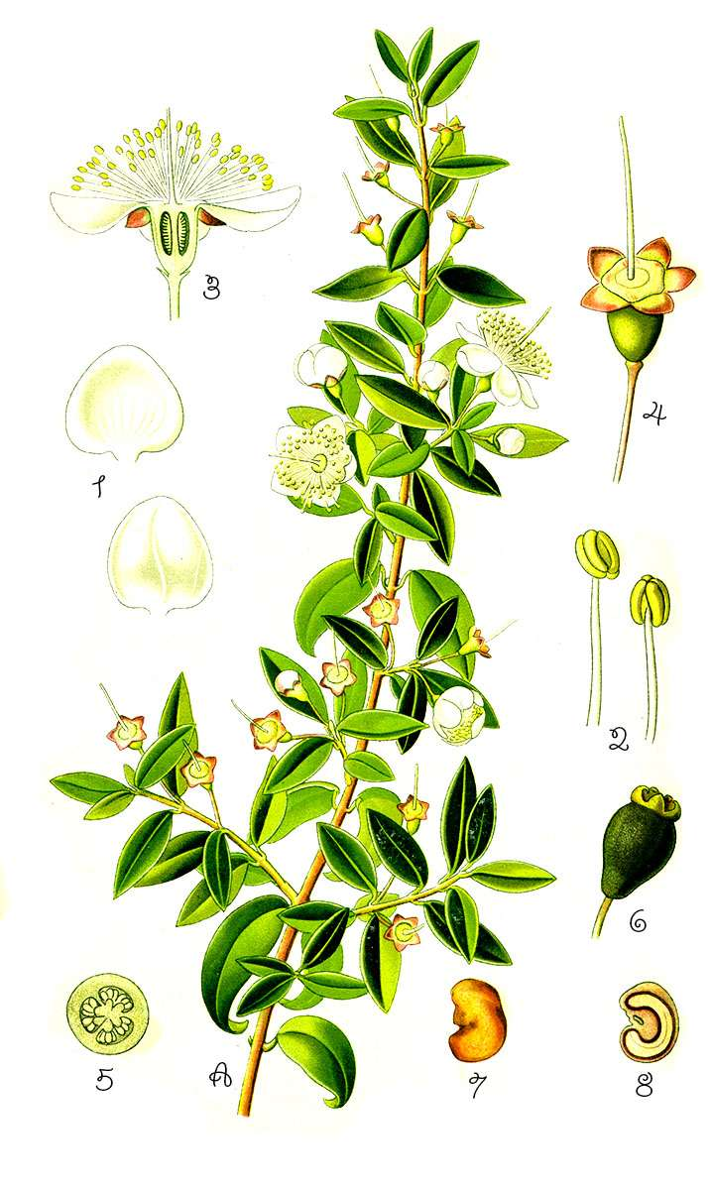
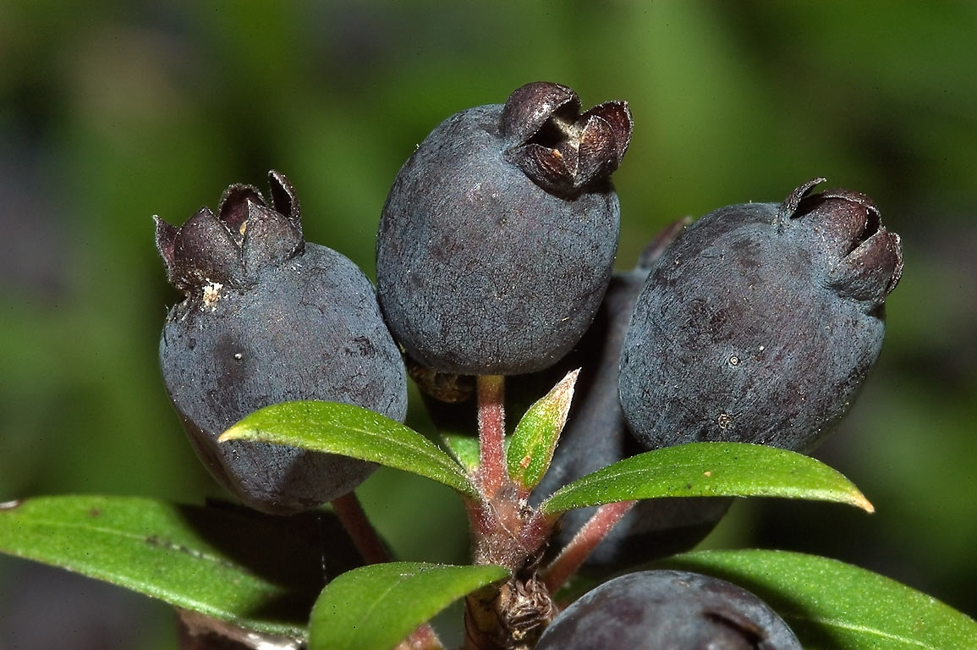
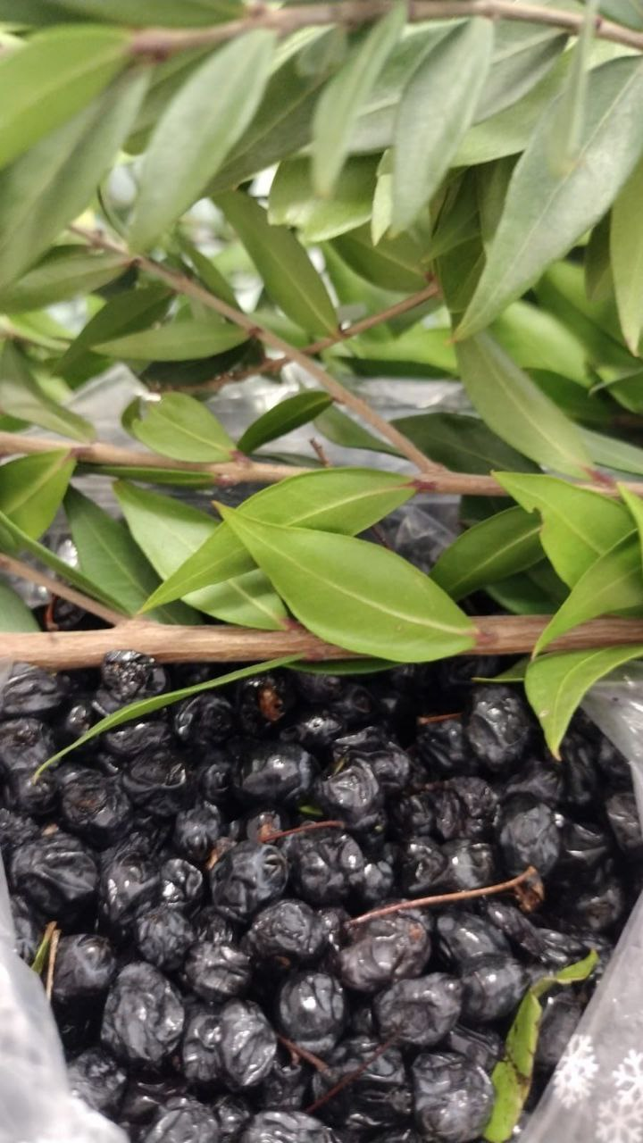
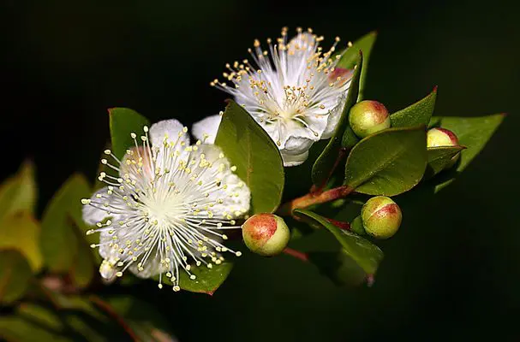
BOTANICAL TABLE
THE BERRIES
A) Sprig of myrtle in bloom
1) Whole bud
2) Pistil
3) Corolla of the flower
4) Inflorescence
5) Horizontal section of the seed
6) Immature fruit
7) Seed
8) Vertical section of the seed
Since the Greek period, myrtle was the favorite plant of the goddess Venus and represented a symbol of love and vitality.

Slide 5
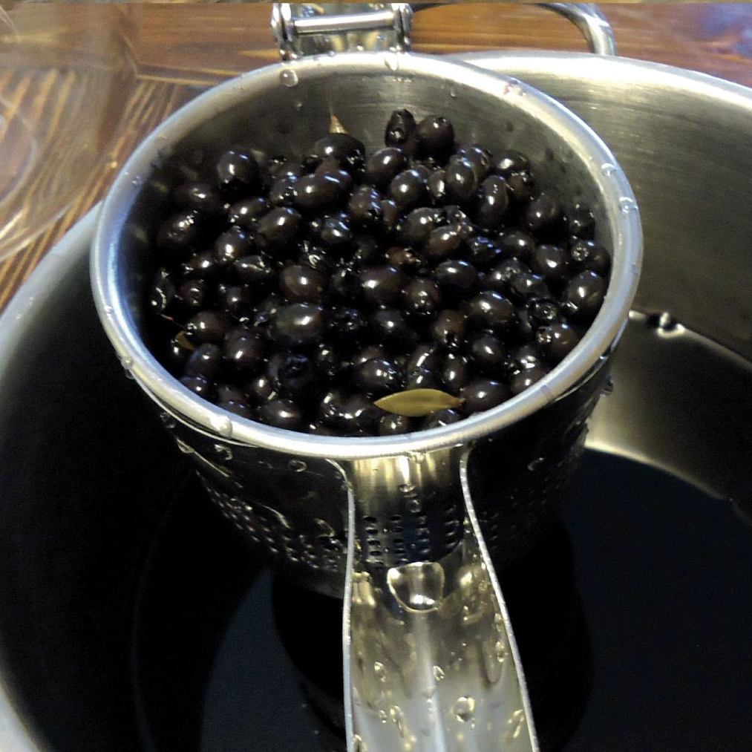
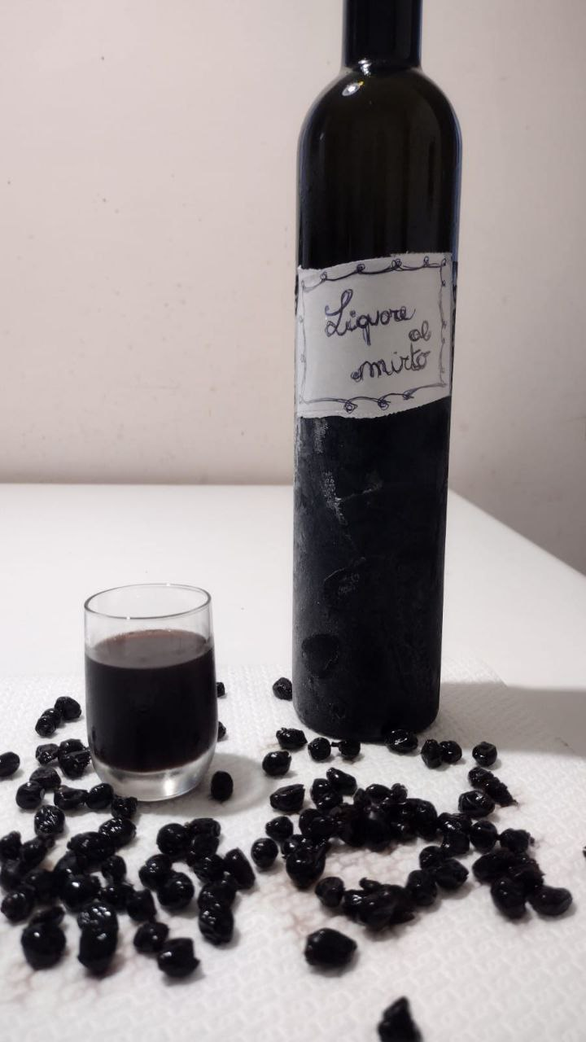
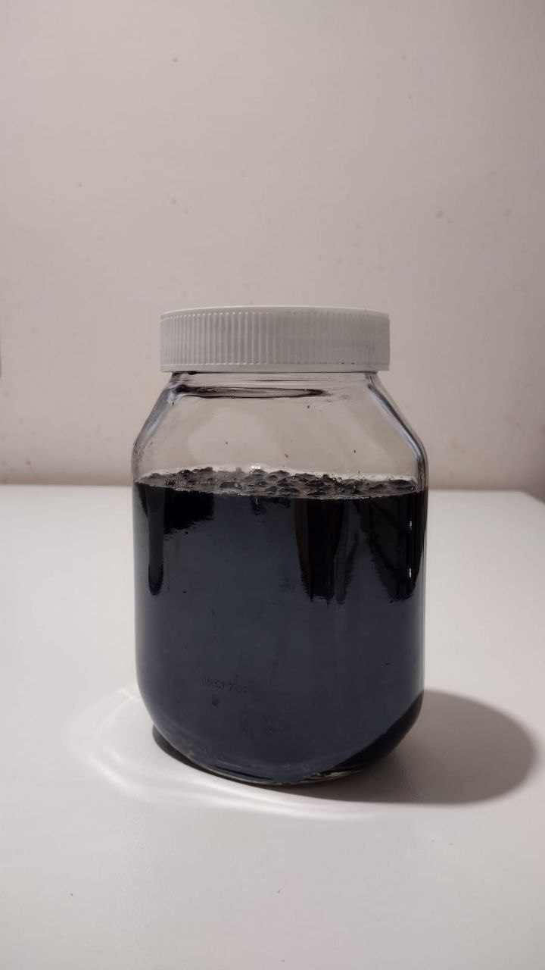
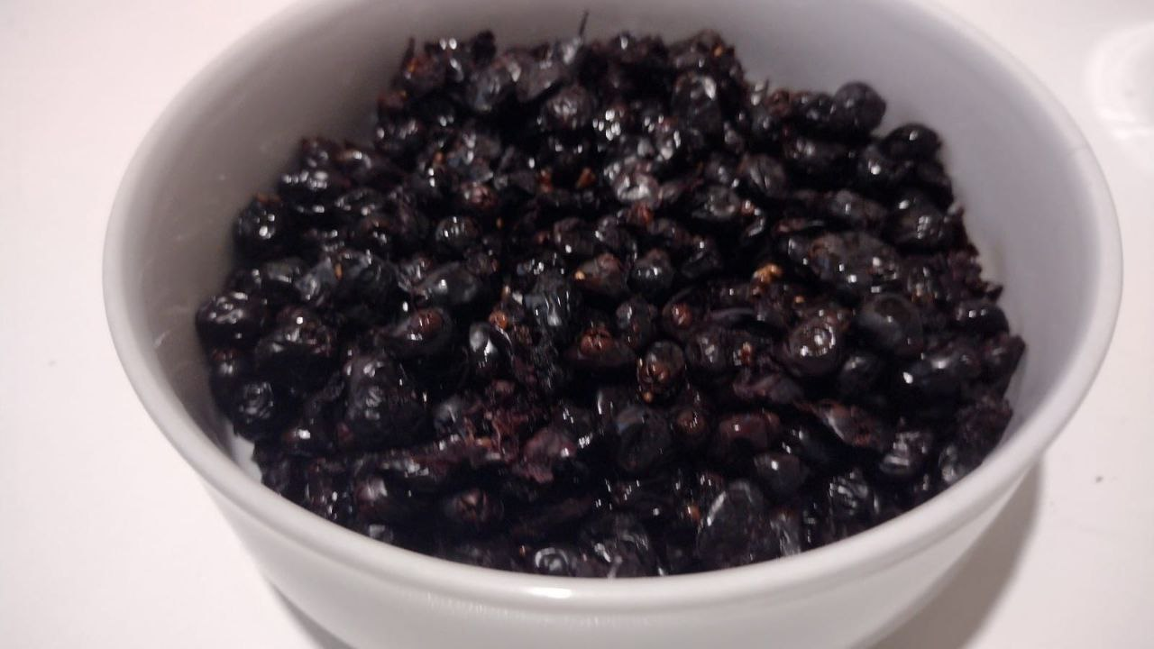
From berries to liqueur ...
The small, round, bluish-black berries are the edible fruits of myrtle.
They are used to flavor meat and fish.
Left to macerate in alcohol for about 40 days, you get an excellent liqueur.
RECIPE
- 500 g of myrtle berries
- 1 liter of water
- 500 g of sugar
- 1liter of alcohol for liqueur

Slide 6
Thank you!

